Slide 1

Autonomus Chess-playing Robot: Chess Piece Movement Detection and Tracking using Artificial Vision
Dennis Aprilla Christie
51410797
Informatics Engineering
Supervised: Dr. Tubagus Maulana Kusuma, SKom., MEngSc.

Slide 2
Outline
Introduction
Background
Problem Statement
Implementation
Chessboard Detection
Result
Pictures
Video
Objectives
Scope
Chesscells Detection
Movement Detection
PGN Generation

Slide 3
Background
Robot was created to help humans perform their work.
Currently, a lot of field need its presence: Industrial field, Medical Field, also Entertainment field.
One of which is Chess-playing robot.
Background (1/2)
Problem Statement
Objectives
Scope

Slide 4
Background
Vision system is crucial for chess-playing robots
They should have a good vision so it can see the chess piece movements accurately in the games.
Computer vision system should be embedded
Background (2/2)
Problem Statement
Objectives
Scope

Slide 5
Problem Statements
How chess-playing robot be able to recognize the entire chess pieces movements?
How vision system be able to identify the chess pieces and their movements?
How vision system can communicate with the robot so it would able to perform the movement for the chess pieces?
Background
Problem Statements
Objectives
Scope

Slide 6
Objectives
Designing a vision system for the chess-playing robot to recognize the entire chess pieces movements.
Designing a tracking mechanism in every chess pieces movement.
Providing chess pieces movement code generation in PGN format
Background
Problem Statements
Objectives
Scope

Slide 7
Scope of the Work
Given an assumption that the chess game will runs normally without interference from the environment outside of the game
One of specific movements of chess piece technique, promotion movement, has not been included.
Background
Problem Statement
Objectives
Scope of the Work

Slide 8
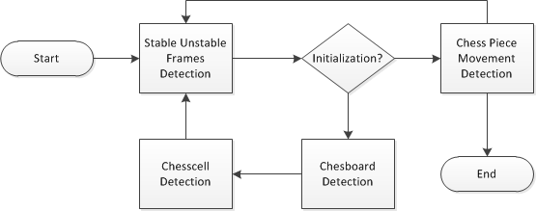
General Description
General Description (1/2)
Chessboard Detect
Chesscells Detect
Movement Detect
Vision system divided into three main phases:
Chessboard Detection
Chesscells Detection
Movement Detection
PGN Generation

Slide 9
General Description
General Description (2/2)
Chessboard Detect
Chesscells Detect
Movement Detect
Where Movement Detection is subdivided into two phases:
Stable Unstable Framed Detection
Chess Piece Movement Detection
PGN Generation

Slide 10
Chessboard Detection
Is a phase to select the region of interest, Chessboard
Aims to provide to ignore environment outside the chessboard
The goal is to wrap chessboard into a perfect square.
General Description
Chessboard Detect (1/8)
Chesscells Detect
Movement Detect
PGN Generation

Slide 11
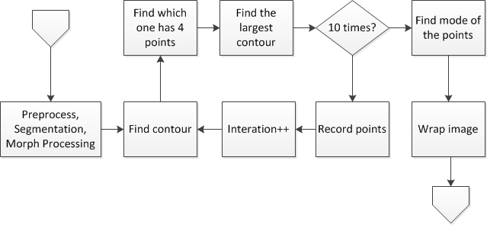
Chessboard Detection Process
General Description
Chessboard Detect (2/8)
Chesscells Detect
Movement Detect
PGN Generation
Chessboard Detection is subdivided into four phases:
Preparation
Find Approximated Chessboard
Find Actual Chessboard
Wrap Chessboard

Slide 12
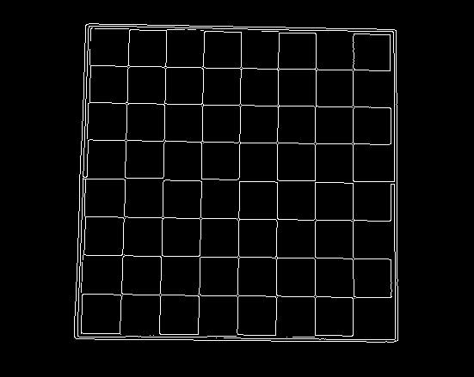
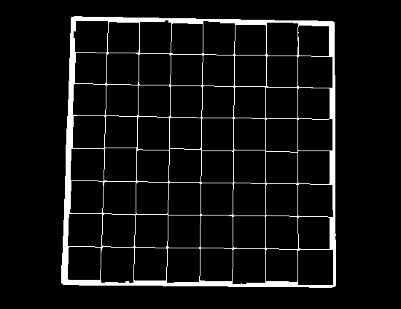
Preparation
Gray-scale, Gaussian Filter, Canny, and Closing Morphology performed
General Description
Chessboard Detect (3/8)
Chesscells Detect
Movement Detect
PGN Generation

Slide 13
Find Approximated Chessboard
The simple process of chessboard detection is as follows:
Performed by Contour Tracing
Followed by searching for the rectangle shape
The largest area of rectangle is assumed as the Approximated Chessboard
General Description
Chessboard Detect (4/8)
Chesscells Detect
Movement Detect
PGN Generation

Slide 14
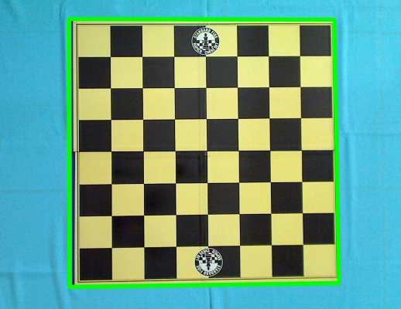
Find Approximated Chessboard
The output of Find Approximated Chessboard is a vector of Points that represents the Chessboard Vertices.
General Description
Chessboard Detect (5/8)
Chesscells Detect
Movement Detect
PGN Generation

Slide 15
Find Actual Chessboard
Taking a decision by using one detection experiments is vulnerable to an error
To reduce the occurrence of errors, vertices position data collection is performed
Mode, one of statistical method, chosen.
Find Actual Chessboard will stabilize chessboard detection process
General Description
Chessboard Detect (6/8)
Chesscells Detect
Movement Detect
PGN Generation

Slide 16
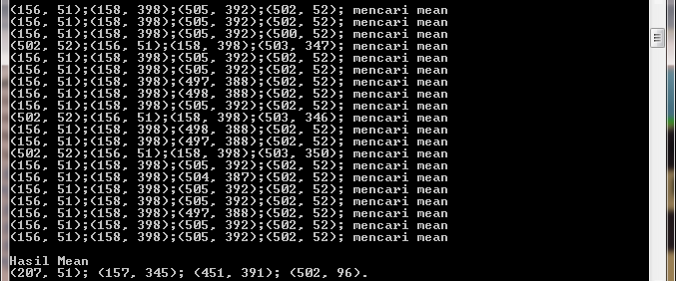
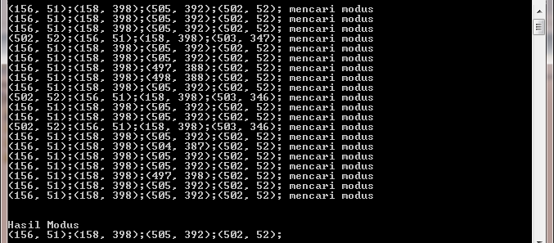
Find Actual Chessboard
General Description
Chessboard Detect (7/8)
Chesscells Detect
Movement Detect
PGN Generation

Slide 17
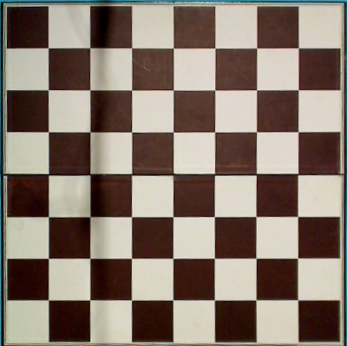
Wrap Chessboard
Chessboard not always in well positioned ,Geometric Transformation can fix chessboard position
General Description
Chessboard Detect (8/8)
Chesscells Detect
Movement Detect
PGN Generation

Slide 18
Chesscells Detection
Is a phase to determine the placement of each chesscells.
Highly participates in chess piece movement detection.
The goal is to give in identity to the entire cells.
General Description
Chessboard Detect
Chesscells Detect (1/10)
Movement Detect
PGN Generation

Slide 19
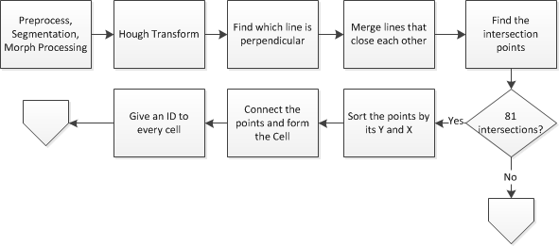
Chesscells Detection Process
General Description
Chessboard Detect
Chesscells Detect (2/10)
Movement Detect
Chesscells Detection is subdivided into five phases:
Preparation
Hough Transformation
Lines selection
Find intersection lines
Cell identification
PGN Generation

Slide 20
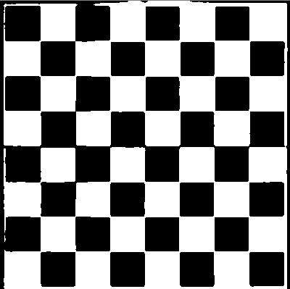
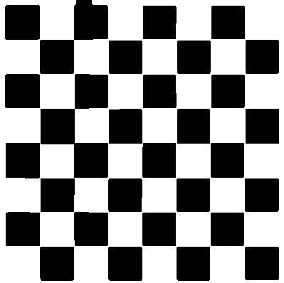
Preparation
Gray-scale, Gaussian Filter, Threshold, and Closing Morphology performed.
General Description
Chessboard Detect
Chesscells Detect (3/10)
Movement Detect
PGN Generation

Slide 21
Hough Transform
Corner detection will behave not expected since the chess piece will also detected as corner.
Cell can be detected by its lines
Hough Transform performed to detect the lines within the chessboard
General Description
Chessboard Detect
Chesscells Detect (4/10)
Movement Detect
PGN Generation

Slide 22
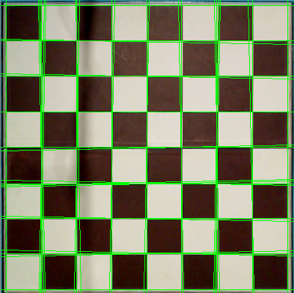
Hough Transform
General Description
Chessboard Detect
Chesscells Detect (5/10)
Movement Detect
PGN Generation

Slide 23
Lines Selection
Lines Selection is performed since the detected lines are numerous.
The rules to obtain expected lines are:
The only accepted lines is the straight lines.
If there were adjacent straight lines, basic statistic mean operation performed to create new lines that represents them.
General Description
Chessboard Detect
Chesscells Detect (6/10)
Movement Detect
PGN Generation

Slide 24
Intersection Lines
Lines Selection will produce only 9 horizontal lines and 9 vertical lines.
Can be obtained with implementing line intersection equation.
General Description
Chessboard Detect
Chesscells Detect (7/10)
Movement Detect
PGN Generation

Slide 25
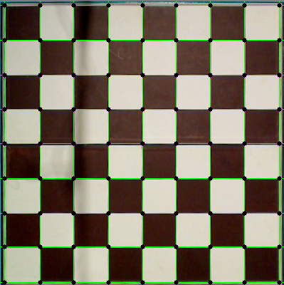
Intersection Lines
General Description
Chessboard Detect
Chesscells Detect (8/10)
Movement Detect
PGN Generation

Slide 26
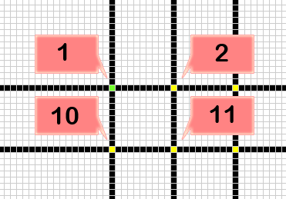
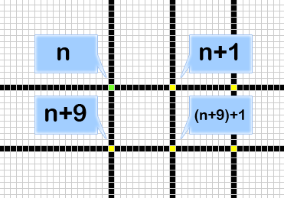
Cells Identification
Intersection Points are still not able to represent a cell understandable by the system.
Rectangular shape becomes a fundamental for Cells Identification
Organization of points into component-forming cell performed
General Description
Chessboard Detect
Chesscells Detect (9/10)
Movement Detect
PGN Generation

Slide 27
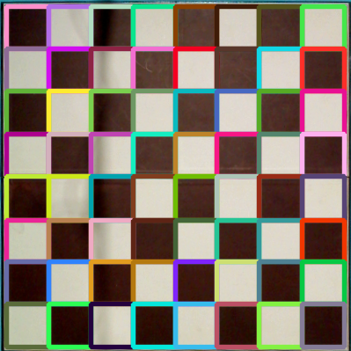
Cells Identification
General Description
Chessboard Detect
Chesscells Detect (10/10)
Movement Detect
PGN Generation

Slide 28
Movement Detection
Chess Piece Movement occur concurrently with robot’s arm movement.
To separate both movements, subdivided into two phases:
Stable and Unstable Frames Detection
Chess Piece Movement Detection
General Description
Chessboard Detect
Chesscells Detect
Movement Detect (1/14)
PGN Generation

Slide 29
Chess Piece Movement Detection
Stable and Unstable Frames Detection will produce two actual stable images
These images will be a reference image to performing chess piece movement determination.
Chess Piece Movement Detection divided into three phase:
Image Subtraction and Obtain Values
Point Mapping
Change the Matrix
General Description
Chessboard Detect
Chesscells Detect
Movement Detect (6/14)
PGN Generation

Slide 30
Stable and Unstable Frames
The goal is to separate the robot’s hand movement and chess piece movement.
Unstable frames are assumed that is a time when robot’s moves the chess piece.
Images will be captured every stable frames occurred.
Both image will compared to determine chess piece movement.
General Description
Chessboard Detect
Chesscells Detect
Movement Detect (2/14)
PGN Generation

Slide 31
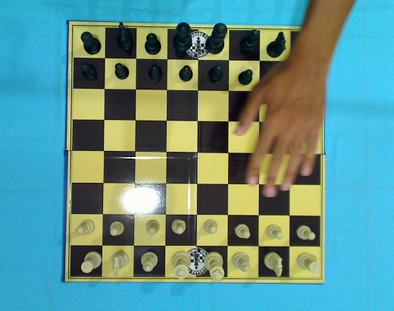
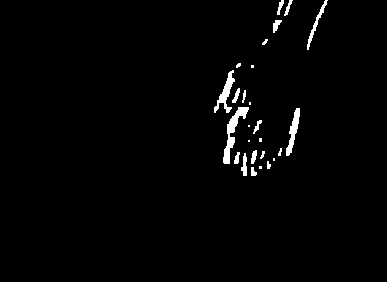
Stable and Unstable Frames
General Description
Chessboard Detect
Chesscells Detect
Movement Detect (3/14)
PGN Generation

Slide 32
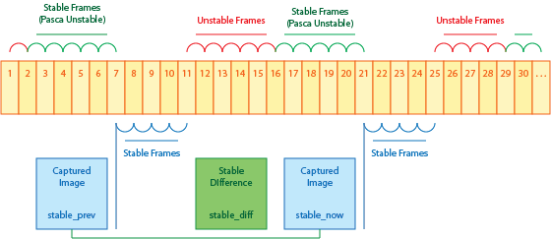
Stable and Unstable Frames
General Description
Chessboard Detect
Chesscells Detect
Movement Detect (4/14)
PGN Generation
Image Subtraction performed every frame
Situation said to be approximate stable, if the number of non-zero pixels is below the threshold

Slide 33
Stable and Unstable Frames
General Description
Chessboard Detect
Chesscells Detect
Movement Detect (5/14)
PGN Generation
Situation said to be actual-stable, If the number of approximate-stable has reached the limit that predefined (n).
Stable image only captured once in the beginning of actual-stable

Slide 34
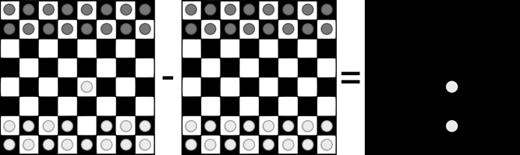
Image Subtraction
General Description
Chessboard Detect
Chesscells Detect
Movement Detect (7/14)
PGN Generation
Image subtraction between two actual-stable image will produce blops.
Series of preparation phase will enhance blops quality.

Slide 35
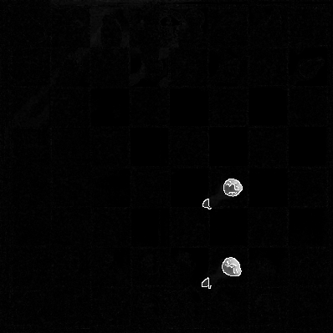
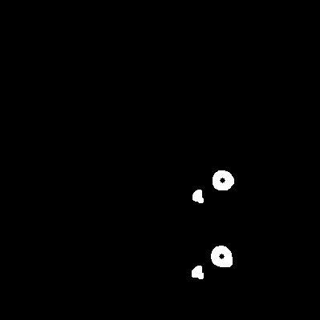


White Turns Blops Detected
General Description
Chessboard Detect
Chesscells Detect
Movement Detect (8/14)
PGN Generation

Slide 36
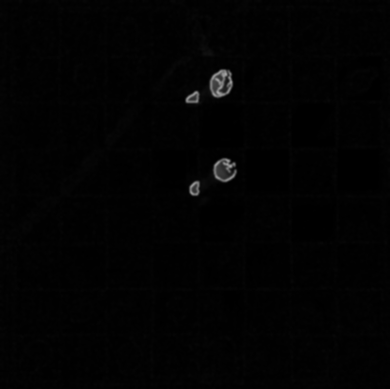
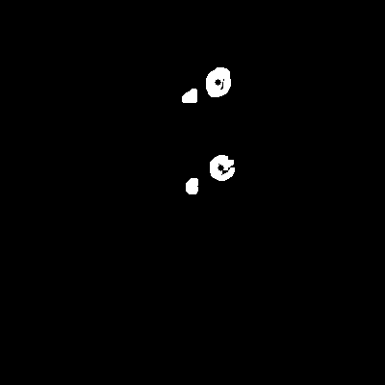
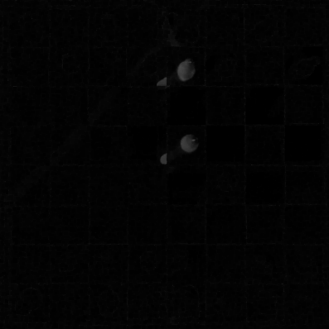

Black Turns Blops Detected
General Description
Chessboard Detect
Chesscells Detect
Movement Detect (9/14)
PGN Generation

Slide 37
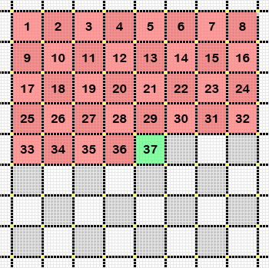
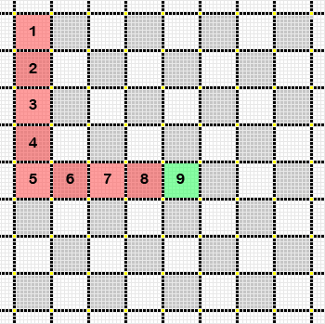
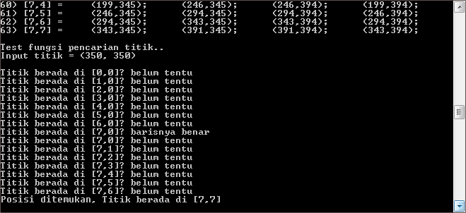
Point Mapping
General Description
Chessboard Detect
Chesscells Detect
Movement Detect (10/14)
PGN Generation

Slide 38
Change Matrix
Chess class is created to manage all the chess game.
Artificial Chessboard created in Chess class in order to understandable by the system.
It is a 8x8 matrix and also contained an Artificial Chess Piece.
This structure will support Chess Piece Movement Tracking to determine the which is moved.
General Description
Chessboard Detect
Chesscells Detect
Movement Detect (11/14)
PGN Generation

Slide 39
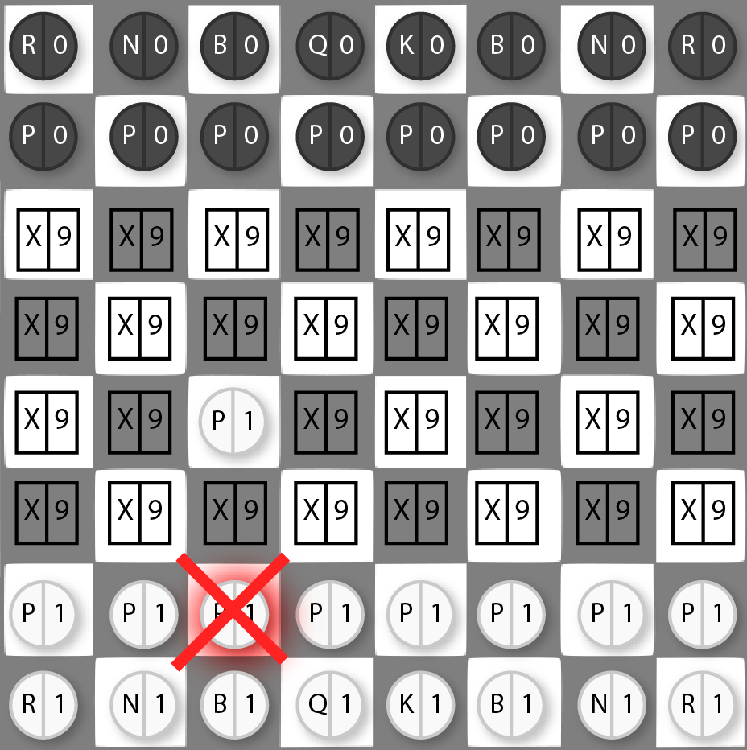
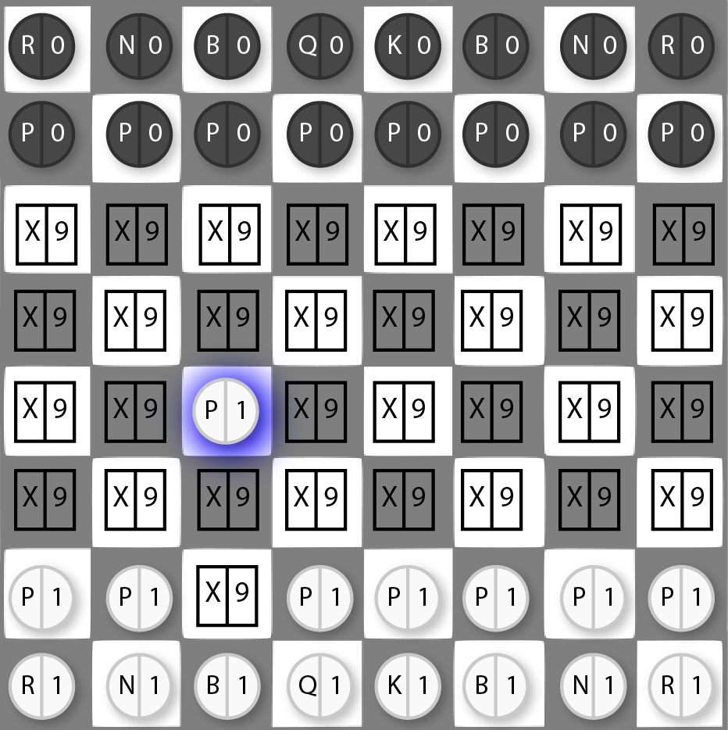
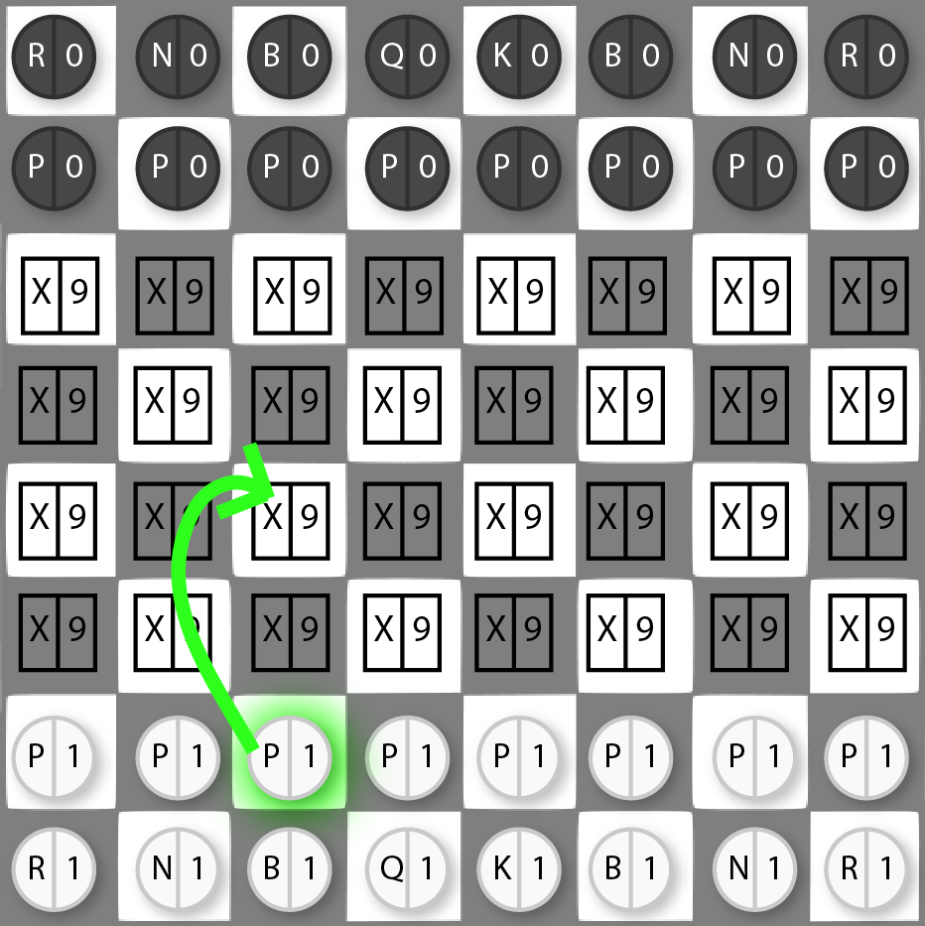
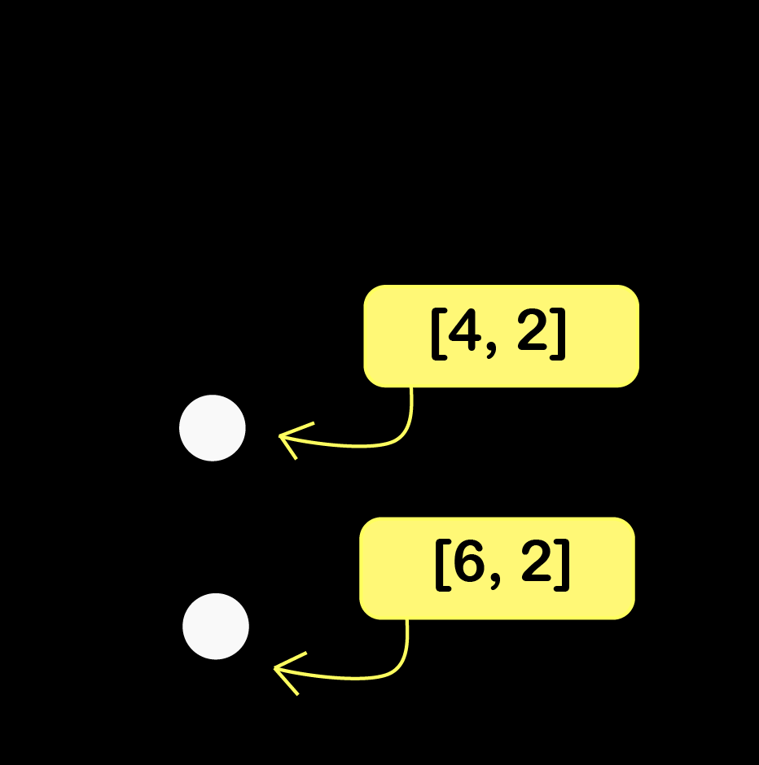
Change Matrix for Normal Move
General Description
Chessboard Detect
Chesscells Detect
Movement Detect (12/14)
PGN Generation

Slide 40
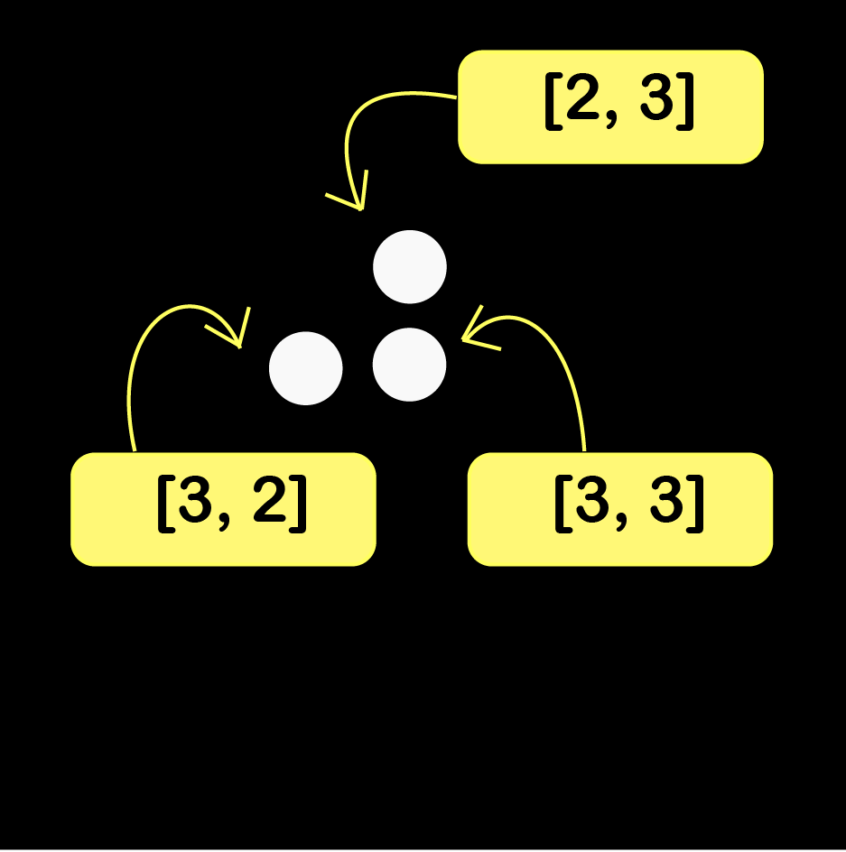
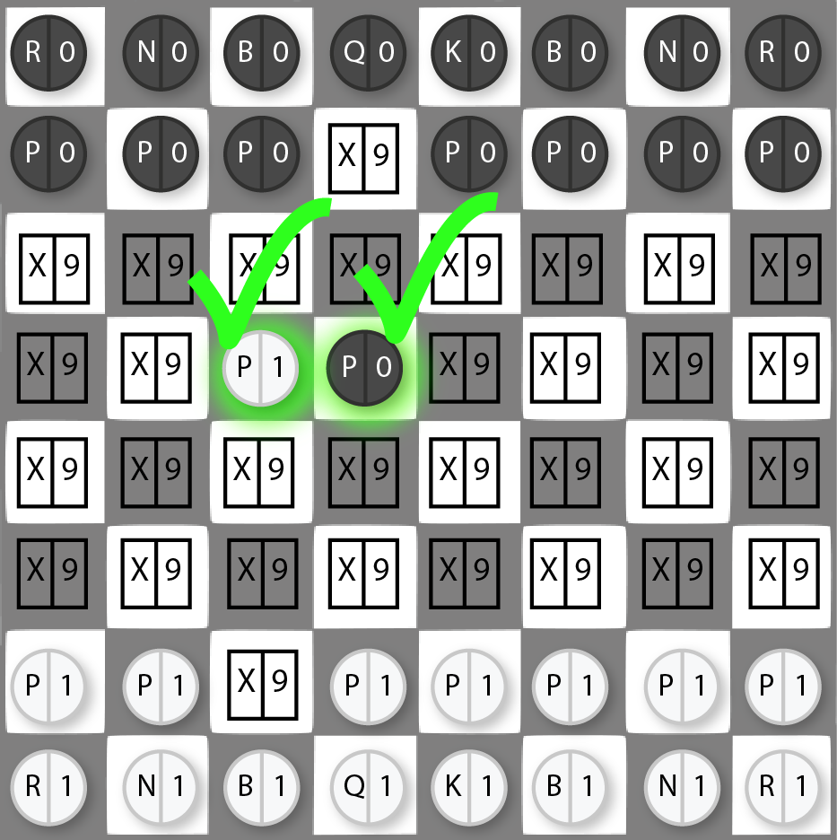
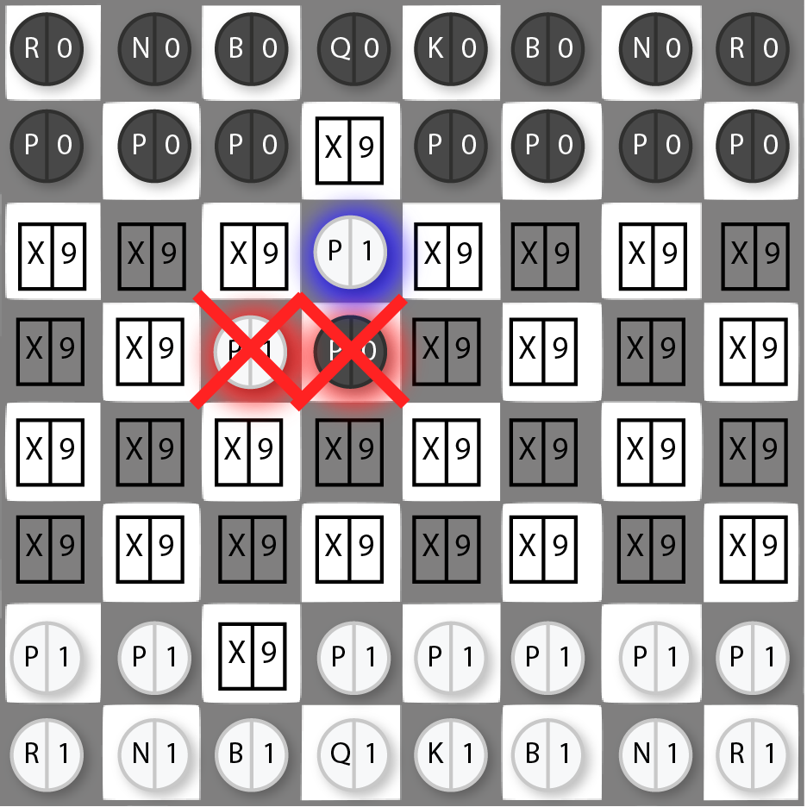
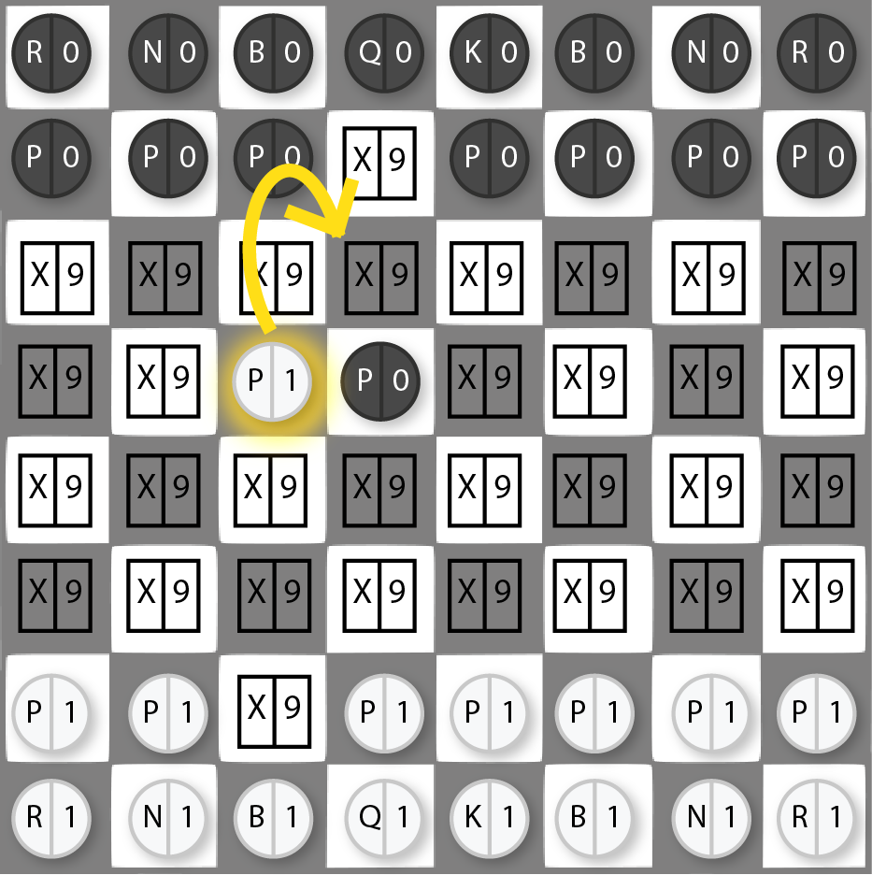
Change Matrix for En-Passant
General Description
Chessboard Detect
Chesscells Detect
Movement Detect (13/14)
PGN Generation

Slide 41
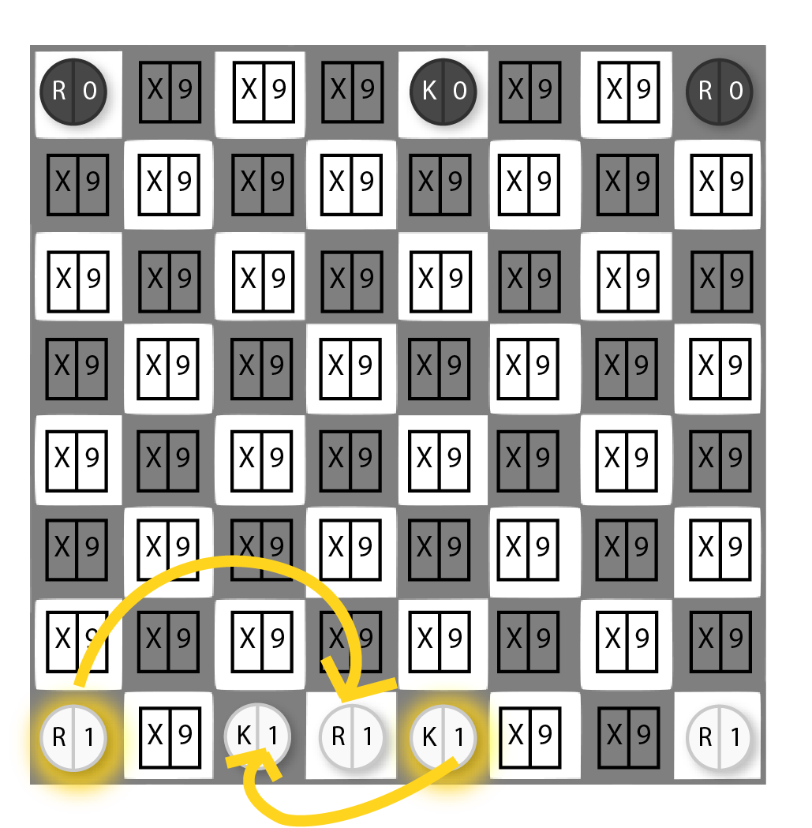
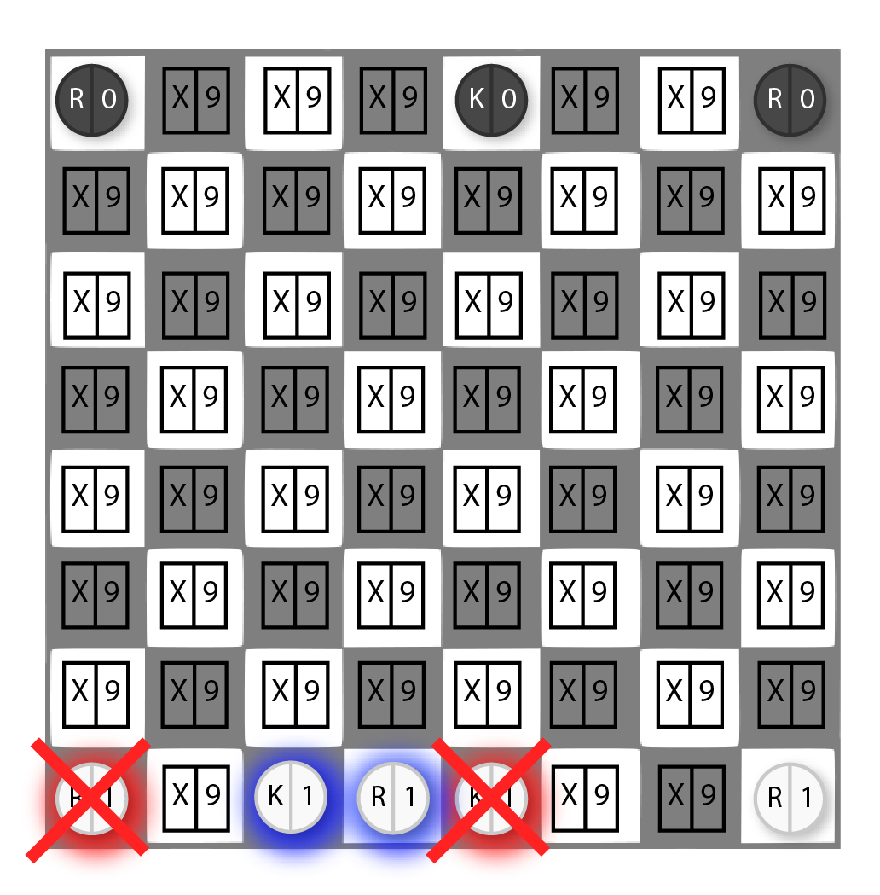
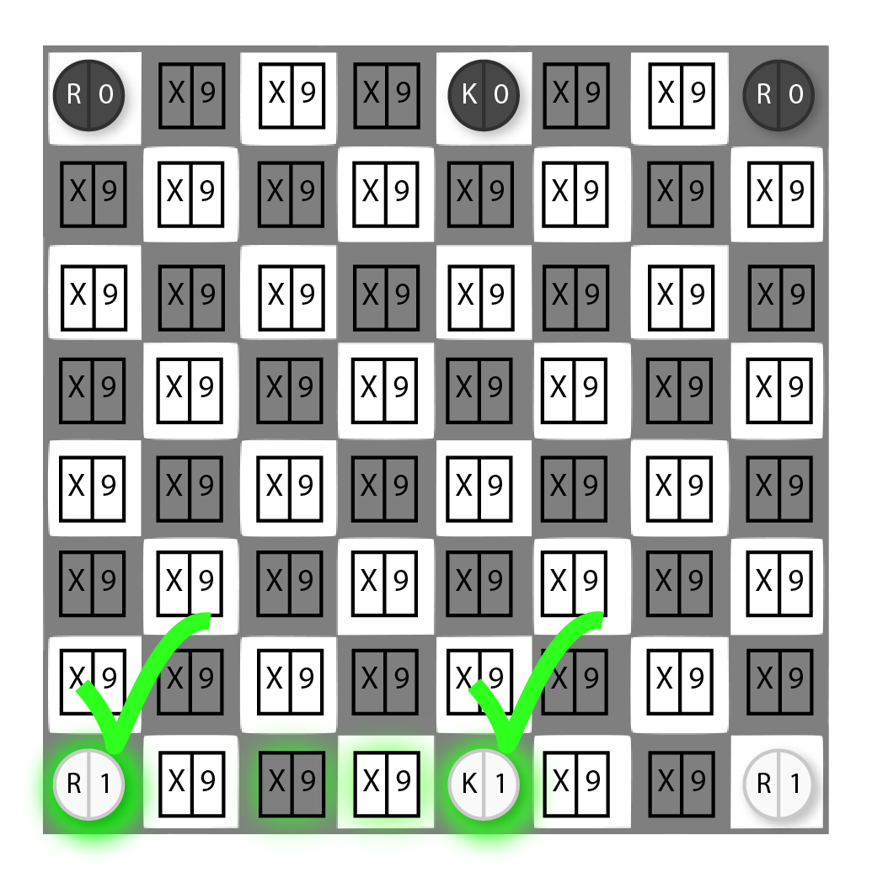
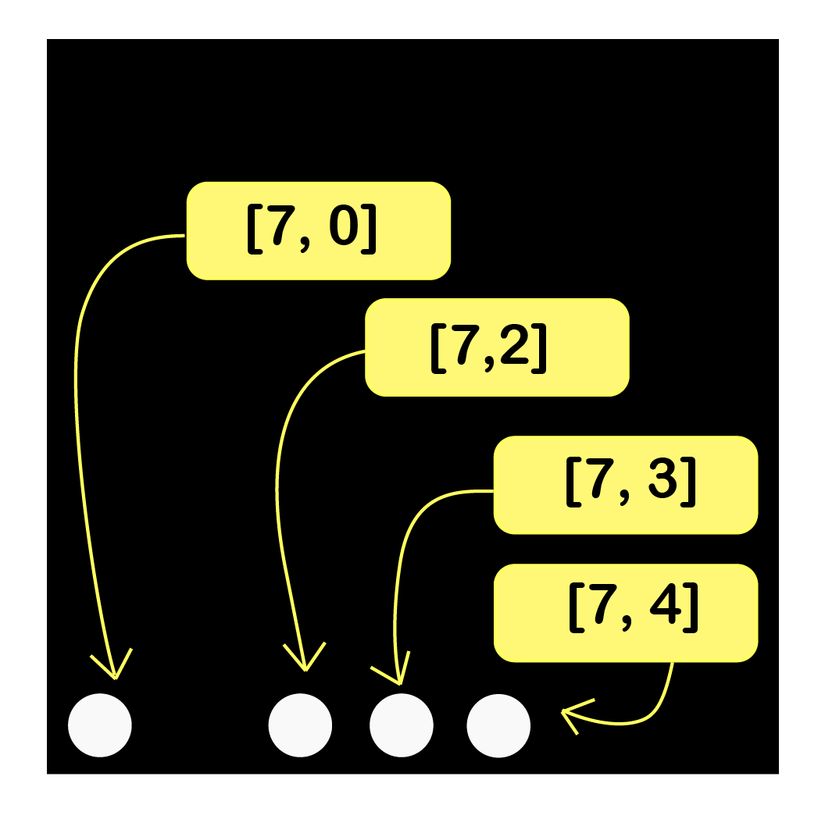
Change Matrix for Castling Move
General Description
Chessboard Detect
Chesscells Detect
Movement Detect (14/14)
PGN Generation

Slide 42
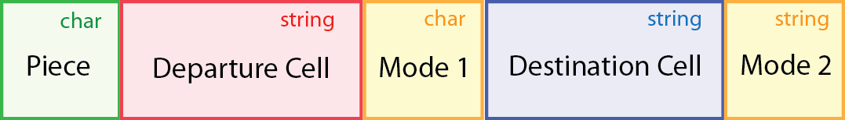

PGN Generation
Chess class also has a behavior to generate the Portable Game Notation
PGN generation is easy to performed by knowing the structure.
General Description
Chessboard Detect
Chesscells Detect
Movement Detect
PGN Generation

Slide 43
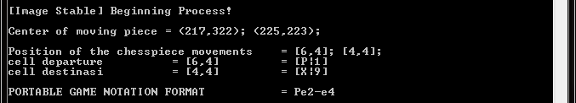
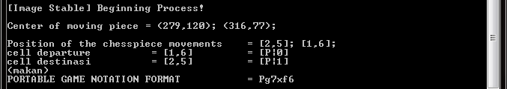
Picture Results

Slide 44
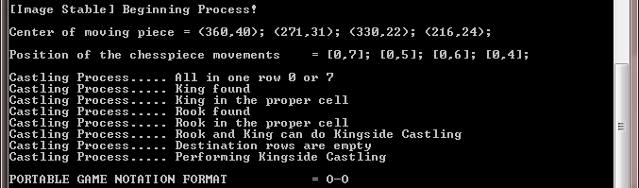
Picture Results

Slide 45
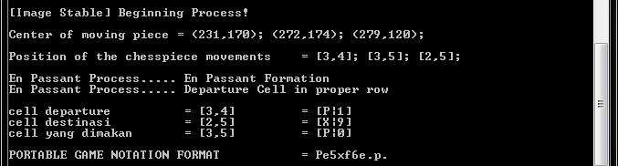
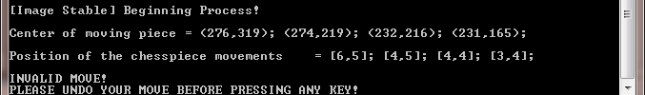
Picture Results

Slide 46
Video Result
► Play Video Result

